Slide 1
Make your vote count again!
You are “We the People” in the Constitution …. Not Big Money … Not Corporations – Unions – Super PACs

Slide 2
BIG MONEY DOMINATES OUR POLITICAL SYSTEM!
HERE’S THE PROBLEM
2016 election spending by Super PACs – big donors
$1.4 billion
Source: Center for Responsive Politics
Our votes have been marginalized by big money and special interests influencing our elections … join us to help take our election process back!

Slide 3
Alan Simpson – August 2017
“Money dominance over politics is the
number one problem our nation faces.”
“Either we are a country that makes decisions based on the common good or one where the size of your wallet determines the worth of your ideas”.
“We are not confused about the differences between human beings and corporations”.
“And no corporation can ever take over the fundamental, inherent rights of human beings – individual citizens”.
“We need a constitutional amendment because the Supreme Court, in cases such as Citizens United v. Federal Election Commission, has made a series of dangerously wrong decisions that make effective reform virtually impossible without one”.

Slide 4
Equating Big Money with Free Speech
HOW WE LOST OUR VOICE
1976 – Buckley vs. Valero …. Spending money to influence elections is constitutionally protected
2010 – Citizen’s United vs. Federal Elections Commission …. Corporations, Unions, Super PACs have the same political speech rights as individual voters
2013 – McCutcheon vs. Federal Elections Commission …
Corporations, unions and individuals can spend unlimited $$$ to advocate for or against political candidates
CREATION OF SUPER PACS
Source: American Promise.org

Slide 5
A CORPORATION IS NOT A PERSON
A Corporation is an artificial entity, created by a state charter and does not possess the inherent, inalienable rights of a human being.
The word Corporation does not appear in the U.S. constitution.
Corporate Personhood and Money = Speech axioms were created by judicial activism – (making laws instead of interpreting the law)
“Let only individuals contribute – with sensible limits per election. Otherwise, we are well on our way to ensuring that a government of the moneyed, by the moneyed, and for the moneyed shall not perish from the earth”.
Warren Buffett

Slide 6
WHAT CORPORATIONS CAN AND CANNOT DO
Corporations can conduct commerce and engage in commercial speech i.e. advertising, marketing, selling.
Corporations can buy – sell – make – create - hire - fire- distribute – compete – conduct research –merge - expand - shrink – fail – make a profit – etc.
Corporation owners and employees can engage in political speech using their own votes as private citizens protected by the U. S. Constitution.
Corporations cannot vote in political elections, only humans can vote
Corporations not engage in political speech since they are not individuals nor political entities.

Slide 7
FLOW OF BIG MONEY INTO OUR ELECTIONS
SPECIAL INTERESTS
CORPORATIONS
UNIONS
INDIVIDUALS
POLITICAL
NON-PROFITS
FOREIGN CORPORATIONS
UNLIMITED
UNLIMITED
$$$$$$$$
SUPER PACs
$$$$
$$$$
501(C)(4)
NON-PROFITS
FULL DISCLOSURE TRANSPARENT
CAMPAIGN ACTIVITIES
$$$$
NOT REQUIRED TO IDENTIFY
HOW $$$$ ARE BEING SPENT.
NON DISCLOSURE “DARK MONEY”

Slide 8
PACS, SUPER PACS and POLITICALLY ACTIVE NON-PROFIT SPENDING BEFORE AND AFTER CITIZENS UNITED
Presidential Elections - Excluding House and Senate
2016 ELECTION = $1.4 BILLION
2004 ELECTION = $688 MILLION
2012 ELECTION = $1.2 BILLION
$600 MILLION OF THIS 2016 FUNDING CAME FROM JUST 195 DONORS
GEORGETOWN UNIVERSITY STUDY
FEC DATA RELEASE JAN 2018

Slide 9
FREEDOM OF SPEECH …. Really?
2016 PRESIDENTIAL ELECTION = $1.4 BILLION
$600 MILLION OF THIS 2016 FUNDING CAME FROM JUST 195 DONORS
how much were you able to give? $25 -- $100 -- $1,000?
Were you able to spend weeks in DC lobbying your Congressman? Do you feel like your one vote counted when compared to the 195 entities who gave millions to promote their special interests?
Since Citizens United decision the voice of the average citizen has all but disappeared.

Slide 10
SOME RESULTS FROM THESE DECISIONS
The cost to campaign and win skyrocketed --- longer campaign times – big organizations - consultants – lobbyists
Members of Congress are forced to spend time fundraising limiting their time to work for us, the American people.
Voters are constantly pounded by negative and deceptive campaign ads and social media during a longer and longer campaign season
Congress addresses the needs of special interests and their lobbyists while neglecting the needs of ordinary citizens
We must make it clear that corporations, unions, and special interest
groups don’t have the same constitutional rights as humans.

Slide 11
SOME BACKGROUND
CITIZENS UNITED v. FEDERAL ELECTIONS COMMISSION
a short video

Slide 12
Americans of all Persuasions Want to Overturn Citizens United
Source: Bloomberg Polling 9/28/2015
“Americans Want Supreme Court to Turn
Off Political Spending Spigot”
Wyomingpromise.org

Slide 13
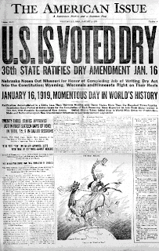
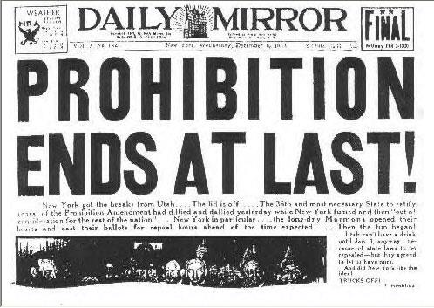
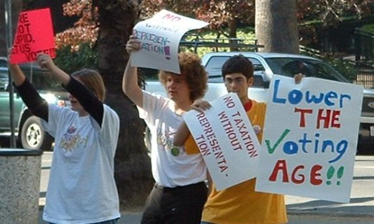
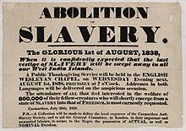
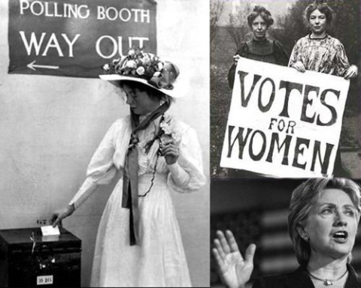
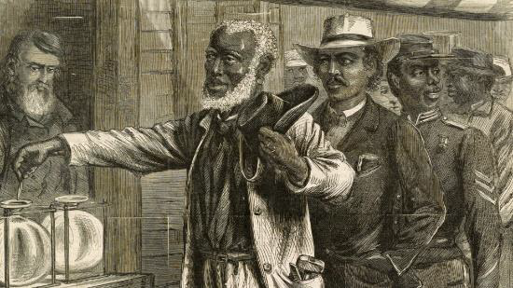
Americans have amended the Constitution 27 times!
8 of these 27 reversed Supreme Court decisions
We can do this!
28th here we come!
Source: American Promise.org

Slide 14
A SOLUTION THAT CAN WORK A Constitutional Amendment
The Constitution currently has 27 Amendments –
Wyoming Promise proposes a 28th that affirms that …
We the People - not big money – not corporations – not unions, govern the United States.
Starts with your signature on a petition to put an initiative – “An Act to Promote Free and Fair Elections”
on the Wyoming ballot in November 2020

Slide 15
WHO WE ARE……
sheridanpromise@gmail.com
……. we are local concerned citizens – from all parties and affiliations who are working as volunteers – not paid lobbyists – we are working to take back our voice, our vote and our democracy.
We are part of Wyoming Promise – created by Wyoming citizens to sponsor an amendment to roll back the 2010 Citizens United decision by the Supreme Court which gave corporations:
the same rights as human individuals
limitless political spending as a form of free speech
Wyoming Promise is a part of a nation wide movement working towards a common goal – a constitutional amendment to repeal Citizens United and regain democracy by the people.

Slide 16
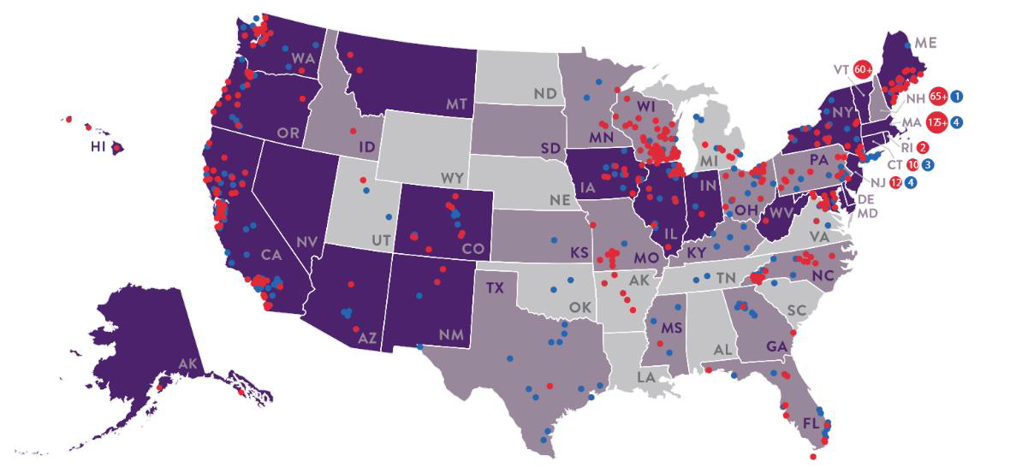
Wyoming has a growing number of active groups
LOCAL RESOLUTIONS PASSED
19 States
800 Cities & Towns
83% Democrats
80% Republicans
71% Independents
Source: Bloomberg 2015
NY Times, PEW Research
Wall street Journal , 2011,
YES Magazine
Wyomingpromise.org

Slide 17
HOW DO WE RECAPTURE OUR REPRESENTATIVE DEMOCRACY ?
First of many steps - we the people must ….
work across party lines to amend the constitution to authorize Congress and the states to limit the political spending of non-human entities….
demand that we as individuals, not global corporations, unions and special interest groups, decide our elections….
build a government where the size of our wallet does not determine the strength of our voice….
insist that all human citizens have an equal voice in deciding who represents them..
Demand that those we elect act as our voice on issues we elected them to address
and be heard – we cannot sit back and expect our politicians to fix the problem.
STEP UP – JOIN THE EFFORT – SIGN THE PETITION - HELP REGAIN YOUR VOICE

Slide 18
How you can get involved ?
Keep learning about this issue—NETWORK and EDUCATE
Sign a petition today ….. then …..
Pick up a petition, take it everywhere you go and
gather signatures from your friends and neighbors.
Remember -- only this paper petition is valid in Wyoming
Donate locally or to wyomingpromise.org to help with
expenses, printing, postage, supplies, etc.
wyomingpromise.org will use your money SPECIFICALLY FOR THIS ONE PURPOSE….
Help us spread the word to get more signatures, talk it up
Use your talents—and join us!

Slide 19
Local Contact: sheridanpromise@gmail.com
and
Wyoming Promise Sheridan County on Facebook
Wyomingpromise.org

Slide 20
THE INITIATIVE PROCESS
Initiative submitted for approval to Wyo Secretary of State
YES
Volunteers gather petition signatures
15% of registered voters in 16 of the 23 Wyoming counties required = 38,818 valid signatures
2,250 minimum in Sheridan County (better make that 3,000 to be safe) 671 = needed in Johnson County
NO
Try Again
Signed petitions submitted to Secretary of State for verification by February 1, 2018
Required # of signatures validated
Keep Going
NO
Wyoming citizens vote Fall 2020 on an
“Act to Promote Free and Fair elections”
YES
Montana and Colorado have passed similar initiatives ….. So far 19 states have called on Congress to propose a constitutional amendment … Wyoming hopes to be the 20th. Many other states are working on the movement.

Slide 21
AMENDING THE CONSTITUTION
PROPOSAL
A CONSTITUTIONAL Amendment can be proposed in one of two ways:
By 2/3 of the members of both the
House and the Senate
At a Convention called by 2/3 of the States
OR
RATIFICATION
After an Amendment is proposed it must be ratified. This can be done in two ways:
By 3/4 of the
Congressional
Members
By 3/4 of ratifying Conventions of the States
OR
Source: ThisNation.com

